Slide 1


MEDISENSE: INTELLIGENT SYMPTOM ANALYSIS & SMART HEALTHCARE NAVIGATION
By- HackHerForce
DEEKSHA CA
HARSHITHA M
LEKHANA S
RUTH R

Slide 2
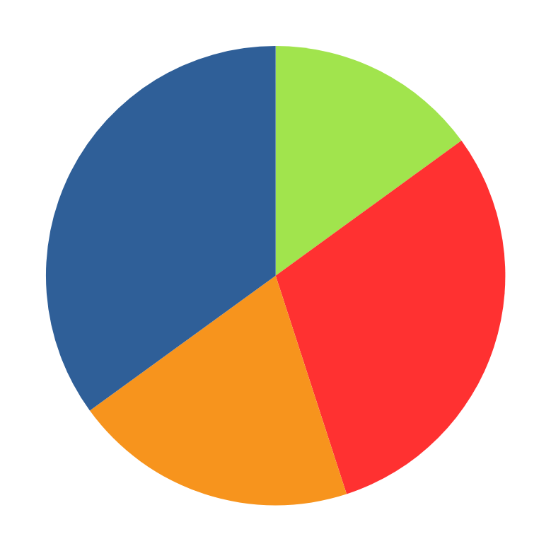
Bridging the Gap:
Rural vs. Urban Healthcare Disparities
70%
30%
Population
Population
India’s population lives in rural areas
India’s population lives in urban areas
40%
60%
Healthcare Infrastructure
Healthcare Infrastructure
of hospitals are located there.
of hospitals are located there.

Slide 3
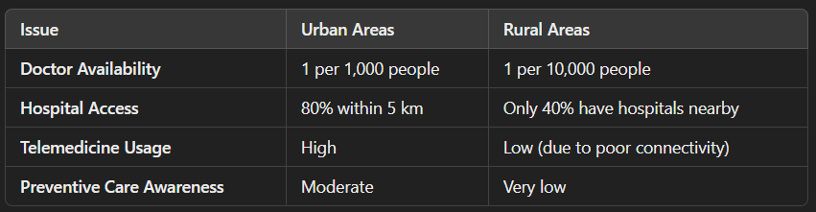
Rural vs. Urban Healthcare Disparities (Cont...)

Slide 4

Our AI-Powered Solution
What We Built:
AI model that predicts health risks in real-time.
Works on IoT devices (smartwatches, wearables, and basic phones).
Uses Azure AI & ML to detect early signs of chronic diseases.
Rural-friendly: Optimized for low-bandwidth 2G/3G networks.

Slide 5
Our AI-Powered Solution
Use Case Example:
A smartwatch detects abnormal heart rate spikes.
AI analyzes the data and predicts a potential cardiac arrest risk.
An instant alert is sent to the doctor and patient, even in remote areas.

Slide 6
How It Works (Flowchart)
Azure IoT Hub.
1
2
3
4
5
6
IOT DEVICES
AZURE STREAM ANALYTICS
AZURE ML MODEL
FHIR API
AZURE LOGIC APPS
POWER BI DASHBOARD
Provides real-time health insights for healthcare professionals.
Collects patient vitals & sends data to Azure IoT Hub.
Processes real-time health data from multiple sources.
Analyzes data, detects anomalies, & predicts health risks.
Secures & stores medical records.
Sends alerts to doctors and patients.
Works with low-speed internet.
SMS-based alerts for areas without smartphones.

Slide 7



Business Model & Revenue
Who Will Use It?
Hospitals → For remote patient monitoring.
Insurance Companies → For risk assessment & cost reduction.
Telemedicine Providers → To enhance rural healthcare access.
Govt. & NGOs → For public healthcare initiatives.

Slide 8
Business Model & Revenue
Revenue Model:
B2B SaaS Subscription – Hospitals pay per patient.
Government Contracts – To deploy in rural healthcare centers.
API Integration – Licensing model for health tech companies & apps.

Slide 9
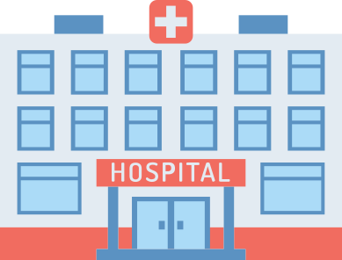





Market Opportunity & Rural Impact
Global Digital Health Market = $500+ Billion (₹41.5 Lakh Crore)
💡 AI in Healthcare growing at 40% CAGR
🚀 Rural AI Healthcare Market = $10B+ (~₹83,000 Crore) in India alone
📉 50% of rural heart attack cases are diagnosed too late.
📶 60% of rural areas lack proper hospital infrastructure.
🩺 AI can reduce rural mortality rates by 30%.

Slide 10
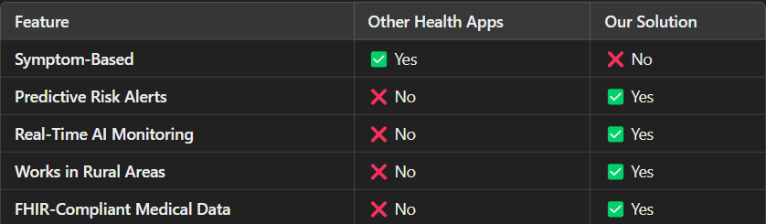
Competitive Advantage
How Are We Different?

Slide 11

Roadmap (Next Steps)
MVP Launch → Pilot in 2 hospitals & rural health centers.
Refine AI Model → Improve accuracy with real patient data.
Go-To-Market Strategy → Partnerships with hospitals & governments.
Expand & Scale → Deploy in 100+ hospitals & rural clinics.

Slide 12

Call to Action (Investment or Partnership)
We are looking for:
🚀 Tech & Business Partners – To scale operations.
💰 Investors – To fund rural pilot deployment.
🏥 Hospitals & Govt. Agencies – For real-world testing.

Slide 13
THANK YOU

